Slide 1
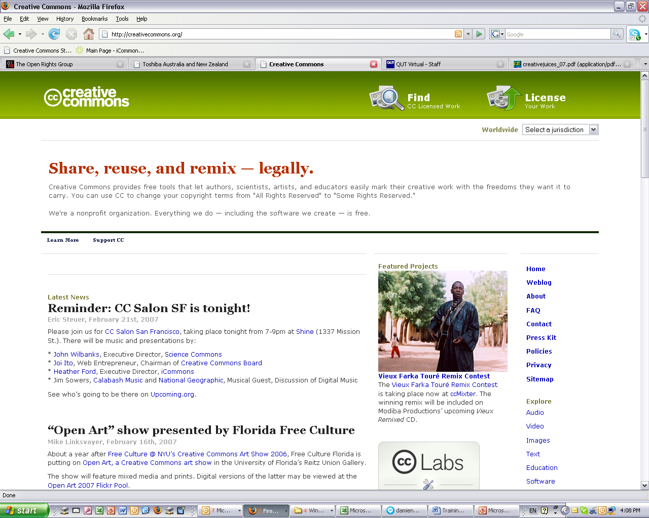



Licences
AUSTRALIA
part of the Creative Commons international initiative
Notes:
To help choose the most appropriate licence, the CC website provides a “licence generator”, which asks simple questions to determine what people are happy to use
By clicking on this button here

Slide 2
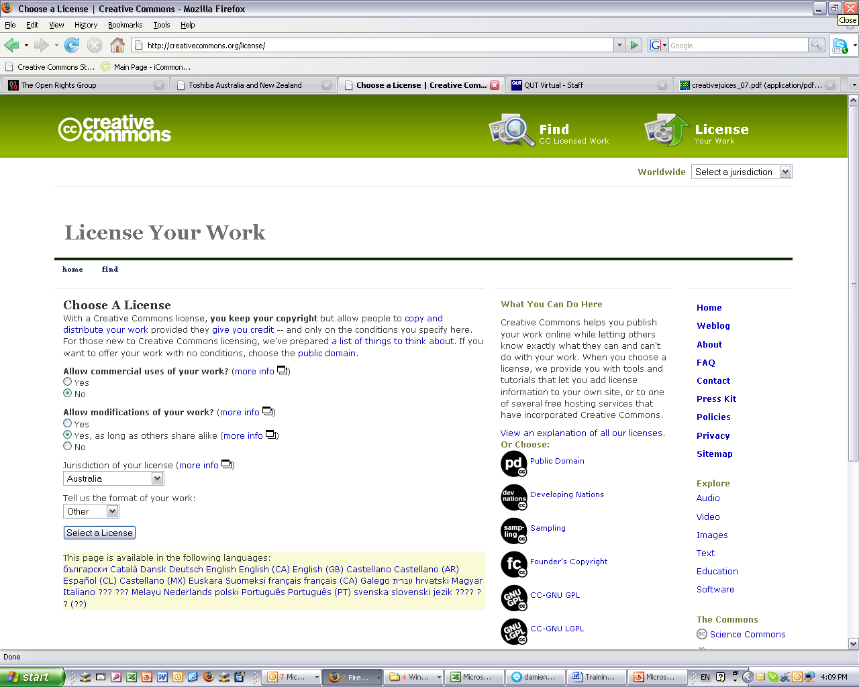
Licences
AUSTRALIA
part of the Creative Commons international initiative
Notes:
To help choose the most appropriate licence, the CC website provides a “licence generator”, which asks simple questions to determine what people are happy to use
By clicking on this button here

Slide 3
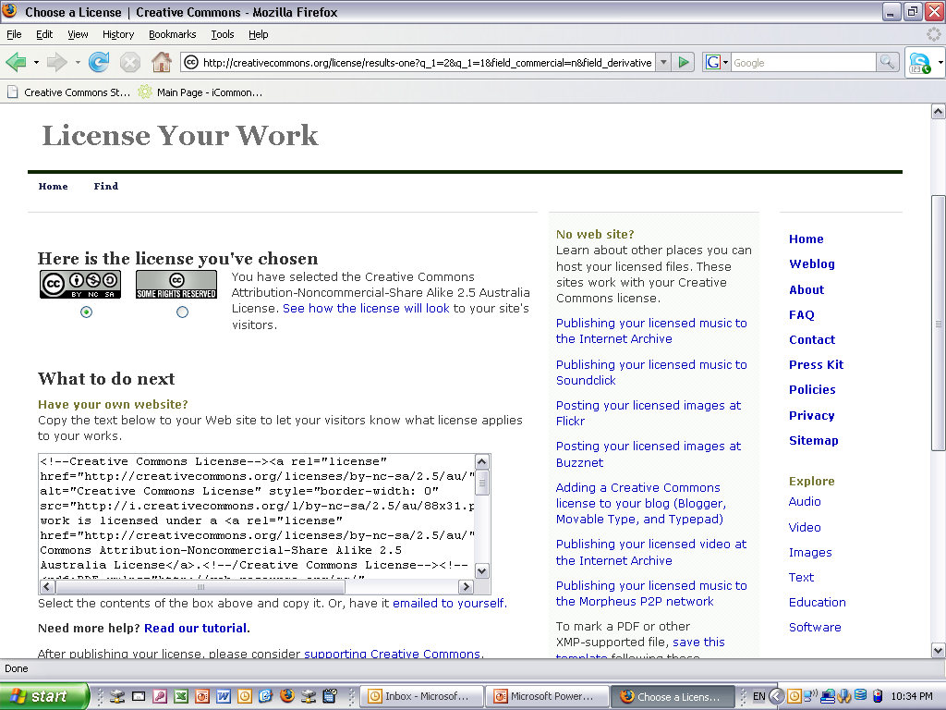
Licences
AUSTRALIA
part of the Creative Commons international initiative
Notes:
Selecting a licence takes you through to a page that provides you with some XHTML text that you can copy onto you website
This basically ‘embeds’ the cc licence into your work, and displays the ‘licence button’ on your site
By clicking on the button, you’re taken through. . .

Slide 4
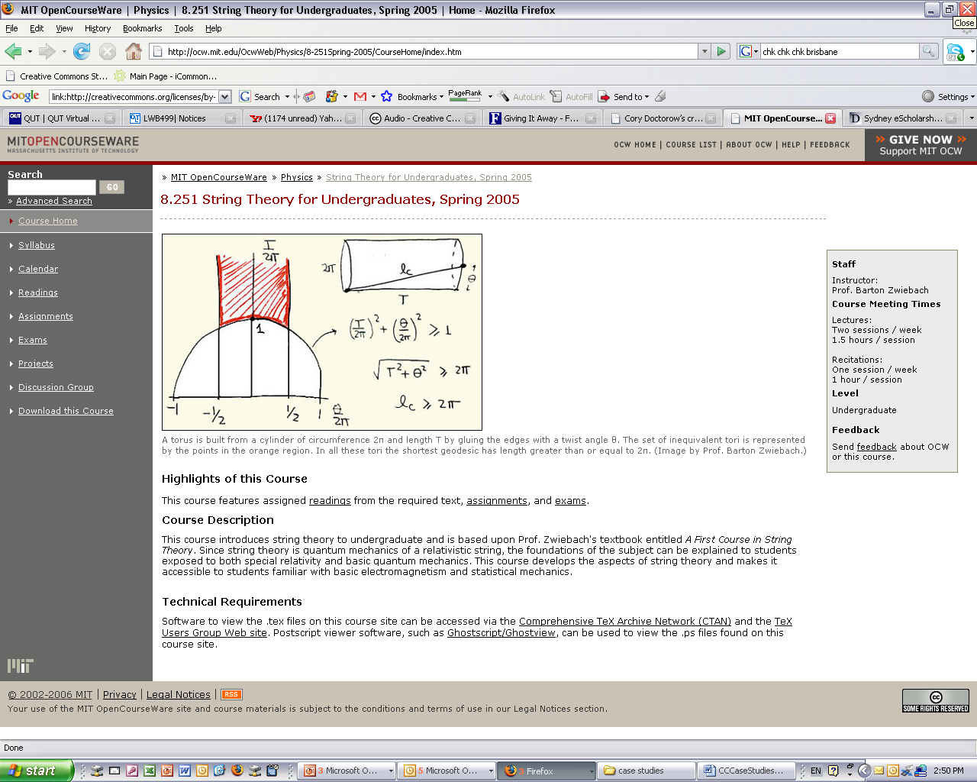
Licences
AUSTRALIA
part of the Creative Commons international initiative
Notes:
Selecting a licence takes you through to a page that provides you with some XHTML text that you can copy onto you website
This basically ‘embeds’ the cc licence into your work, and displays the ‘licence button’ on your site
By clicking on the button, you’re taken through. . .

Slide 5
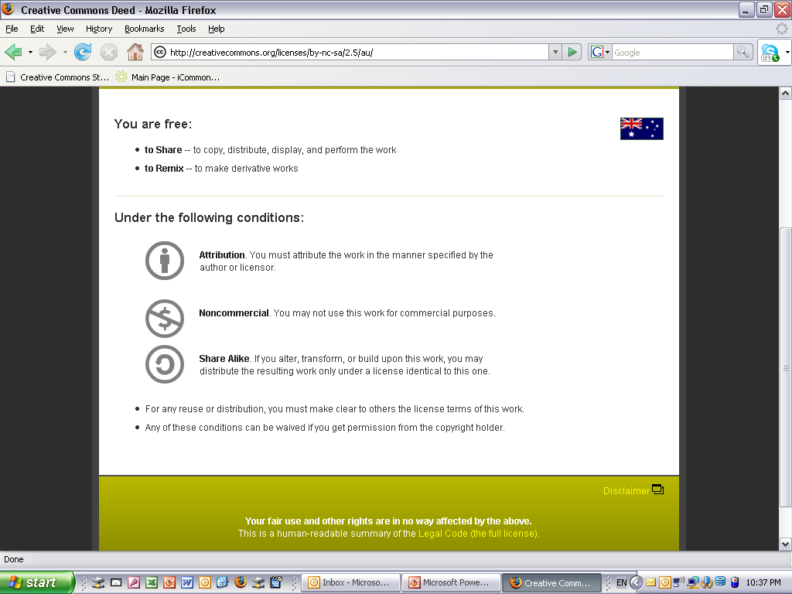
Licences
AUSTRALIA
part of the Creative Commons international initiative
Notes:
. . .to the licence deed, which sets out the licence in plain english terms
You can see the licence element symbols here
By clicking on this link here, you can access . . .

Slide 6
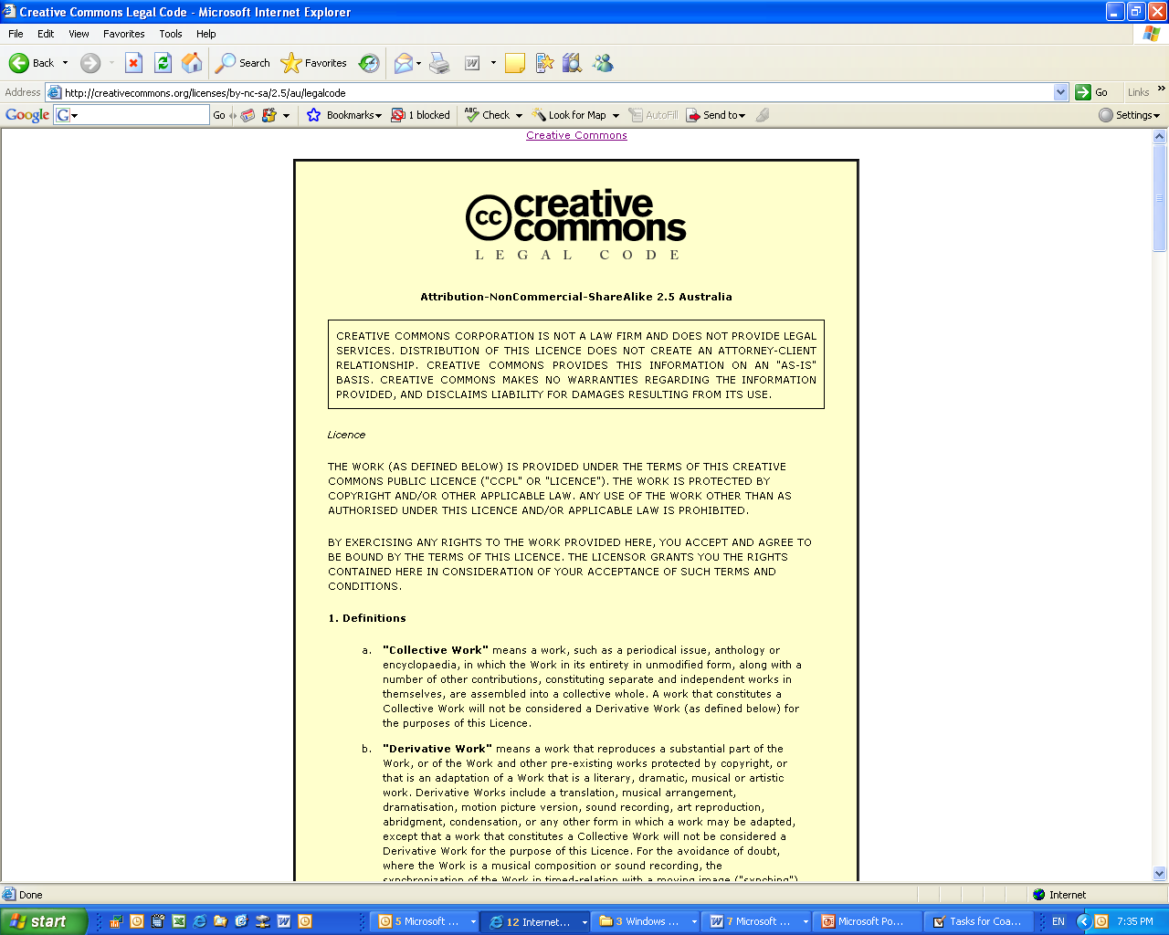
Licences
AUSTRALIA
part of the Creative Commons international initiative
Notes:
The full licence code – which sets out the licence in full legal terms

